Slide 1


BODY FACTORY
GROUP MEMBERS:
ZEESHAN
ANAS ALI
MUHAMMAD UMER

Slide 2

WHAT IS BODY FACTORY?
Our project is an automated workout/fitness plan which is made with C++ language. It utilizes all the rules and abilities of Objected Oriented Language. It is solely a consoled based application.

Slide 3

Aim of this project
In this rapidly developing world, we see our life becoming easier day by day. Just like that, fitness or workout is an essential part of our life. Every person wishes to have a perfect body, but complexity in finding an efficient plan has made its reach out of most of the people. To end this problem, we are bringing our project with an aim to provide an easy, efficient way to have your required fitness plan in your hands just within few clicks. People, also after having a plan, stuck in confusion that how to perform a specific exercise. Our attempts to provide a video clip for each exercise will be surely a great assistant for them. They won’t have to pay thousands to have a trainer.

Slide 4

operation
A user is asked to input name, age, gender, weight, height, contact number.
Our program will calculate BMI. Then user will be asked about the level of fitness/workout plan he wants.
After his selection of any of the option, he will be provided with complete diet, fitness and workout plan of whole specific period.

Slide 5
Libraries:
6 pre-defined libraries
#include<iostream>
#include<conio.h>
#include<fstream>
#include<string>
#include <windows.h>
#include<mmsystem.h>
1 user-defined library
#include"project_required.h"
- 6 functions were defined in the library

Slide 6
What about the people who are unaware of the exercises we provide?
Major issue people find while searching for an efficient fitness plan is that they are unaware of the exercises. As our aim is to promote easiness, we will be providing a video clip of a trainer for each exercise, who will be performing those.

Slide 7
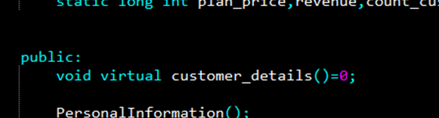
Features:
INHERITANCE – (HEIRARCHAL)
ABSTRACT CLASSES
VIRTUAL FUNCTION
ENCAPSULATION
FILING

Slide 8
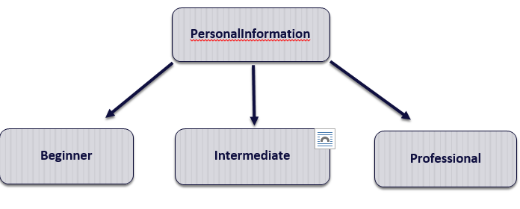
INHERITANCE

Slide 9
FEATURES:
CONST - KEYWORD
STATIC – KEYWORD
ABSTRACTION
TEMPLATE FUNCTION
SUBSTR- FUNCTION
STRING_FINDER

Slide 10
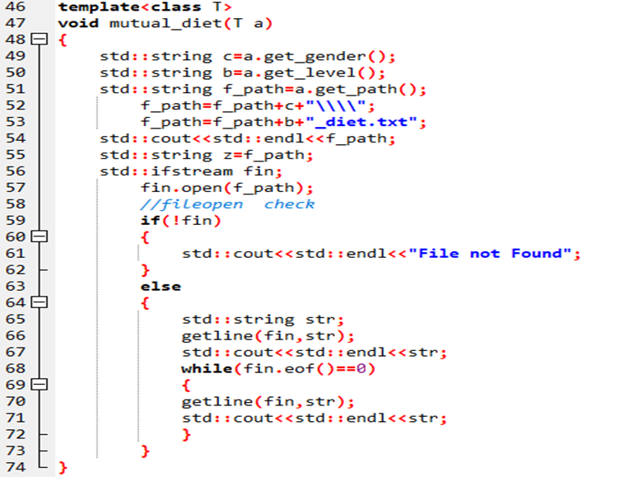
Template function

Slide 11
Template function explaination
In this function we are Just opening the file in which we have written the diet plan. This function was required in all classes to open the files according to the user’s level and gender. So this is why we used template function. To get the path of a folder in which our diet plan file is saved ,We used a.get_level() and a.get_gender() fuction that will take the level and gender from an object out of (beginner,intermediate,professional) classes. We are concadenating string (string +string ) and then finally, they join with f_path (i.e ,the path of a file in our .cpp file directory). By this f_path string we are opening our file.

Slide 12
encapsulation
To keep the data safe from misuse and outer interface
To keep the data secure, we tried to hide most of the data from main interface.
Most of the functions were defined in our user-defined library, which will keep the functions safe and out of the reach of user.
Other than the library, we used access specifiers to keep the specific members private and/or protected, and out of the reach of users

Slide 13
DATA MEMBERS
Private:
string name;
int age;
string gender;
float height,weight;
string contact,NIC;
string f_path2;

Slide 14
Protected:
string level;
string f_path;
Public:
float BMI;
static long int plan_price,
revenue,
count_customers;

Slide 15
MEMBER FUNCTIONS
Void showdata();
string get_level(void)
string get_path(void) {
string get_gender(void) {
virtual void display()const
static void price(void)
void cal_f_hours(void)
void display()const

Slide 16
Image SLide
Substr function():
This is the built-in function of string in C++. It takes 2 arguments (1st position, Last position) and it saves the string occurs between these position in a separate variable. We used this buil in function in our string_finder() function that is discussed below.
String_finder():
In this function We are finding a selective data from our string. We are taking customers name, gender and previous weight from a file . The function takes the NIC of a user, a word to be searched, and end word. From the NIC, the function is opening a customers file and then start reading from the beginning,
In if condition we are finding the position of our searched word that we passed in our function. Once we get the position then we are passing this in the substr(). That will give us the string between the searched word and last position. This function will return the string that is stored by substr() function.

Slide 17
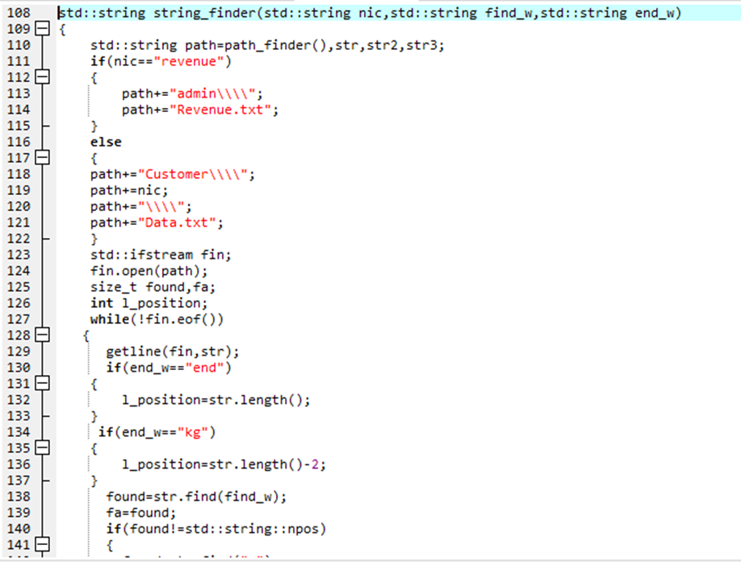

Slide 18
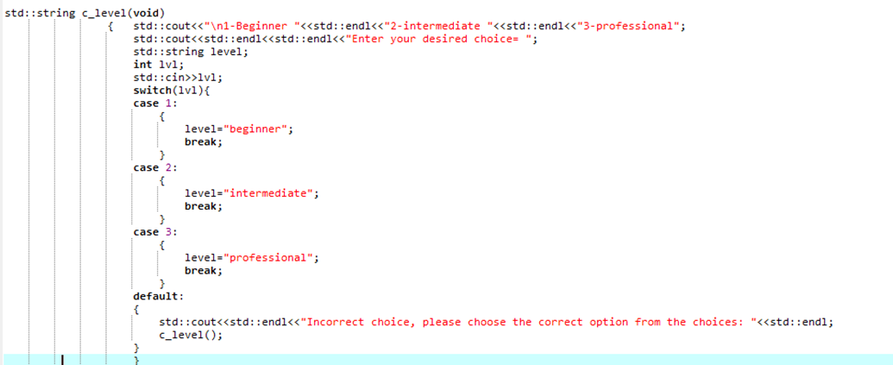
string c_level(void): This function is just taking the choice of a level (beginner,intermediate,professional) from a user. The main purpose to create this function is that if a user enters any other number than 1,2 and 3 then the function will recurse and again ask the user to enter right level from the choices. This function will return the level to our main().

Slide 19
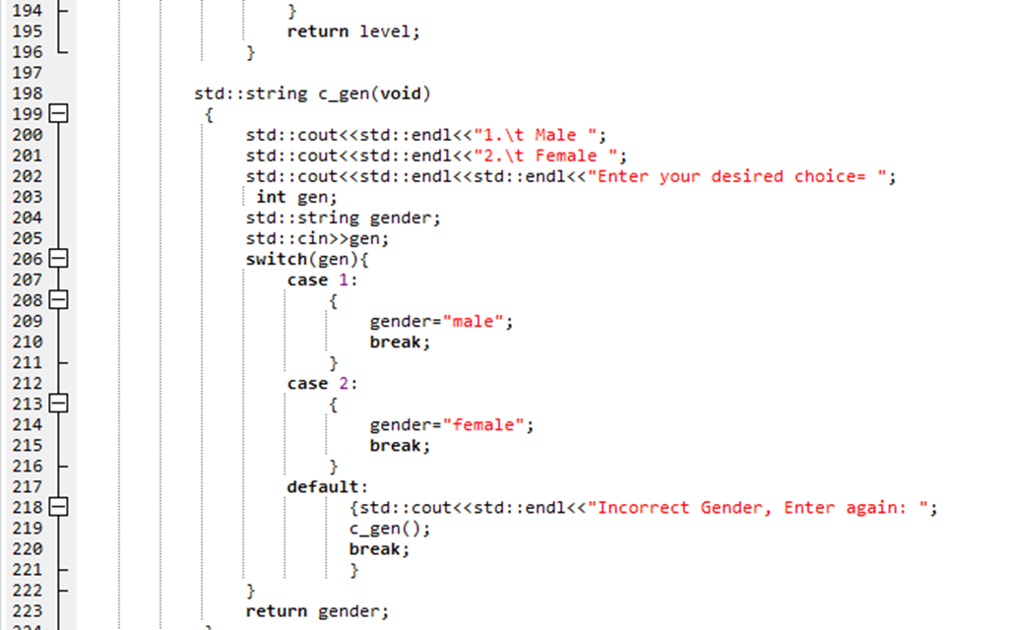
string c_gen(void):
This function is just taking the choice of a gender (Male, Female) from a user. The main purpose to create this function is that if a user enters any other number than 1 and 2 then the function will recurse and again ask the user to enter right gender from the choices. This function will return the gender to our main().

Slide 20
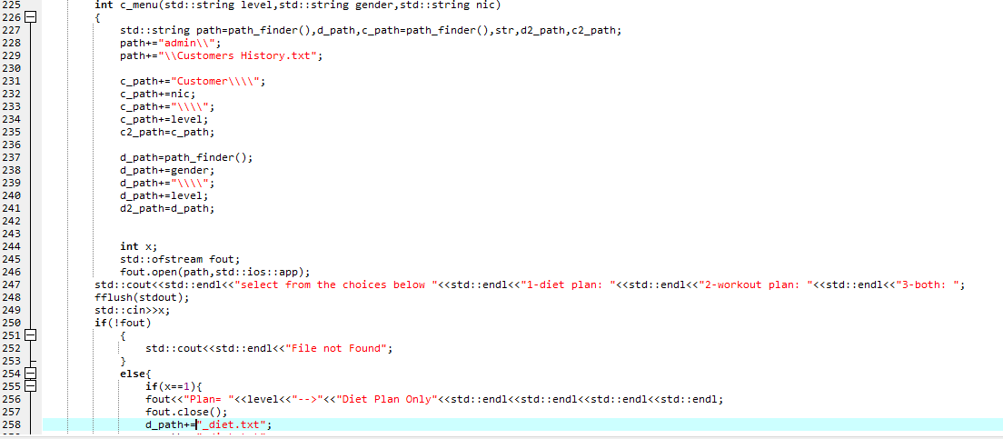
C_menu():
This function will ask the user to select which program He/She want. If user enters the wrong choice then the function will recurse itself and ask the user to enter the correct choice from the menu. This function will also copy a file of a plan that user takes into the folder of that particular user.

Slide 21
Class diagram
PersonalInformation
- string name; - int age; - string gender; - float height,weight; - string contact,NIC; - string f_path2; # string level; #string f_path; + float BMI; + static long int plan_price, + revenue, + count_customers;
+Void showdata(); +string get_level(void) +string get_path(void) { +string get_gender(void) { +virtual void display()const +static void price(void) +void cal_f_hours(void) +void display()const

Slide 22
Beginner
-string lvl; -gen; +float freeHours;
+cal_f_hours(void) +virtual customer_details() +display()const

Slide 23
Intermediate
-string lvl; -gen; +float freeHours;
+cal_f_hours(void) +virtual customer_details() +display()const

Slide 24
Professional
-string lvl; -gen; +float freeHours;
+cal_f_hours(void) +virtual customer_details() +display()const

Slide 25
THANK YOU
WOODGROVE BANK

